Slide 1
B: Introduction to TMB
Day 1: 09h00-11h00
Notes:
a

Slide 2
Specifying the Problem
TMB programs are written using a template (stored in a CPP file).
The CPP file specifies:
  the function to be minimized ;
  the parameters that are to be varied to minimize the function;
  any variables that depend on the parameters, but are not parameters themselves; and
  the data (constants) that are part of the function.
The function is minimized from R.

Slide 3
The TMB “Approach”
Read in the data
Create R lists that specify the data and the parameters.
Create a .CPP file. This file provides the specifications to:
  identify the parameters and any derived variables;
  define the model; and
  define the objective function to be minimized.
Compile and link the resultant C++ program as you would any other C++ program (done through R).
Link the compiled CPP code
Run the analysis and analyze the results.

Slide 4
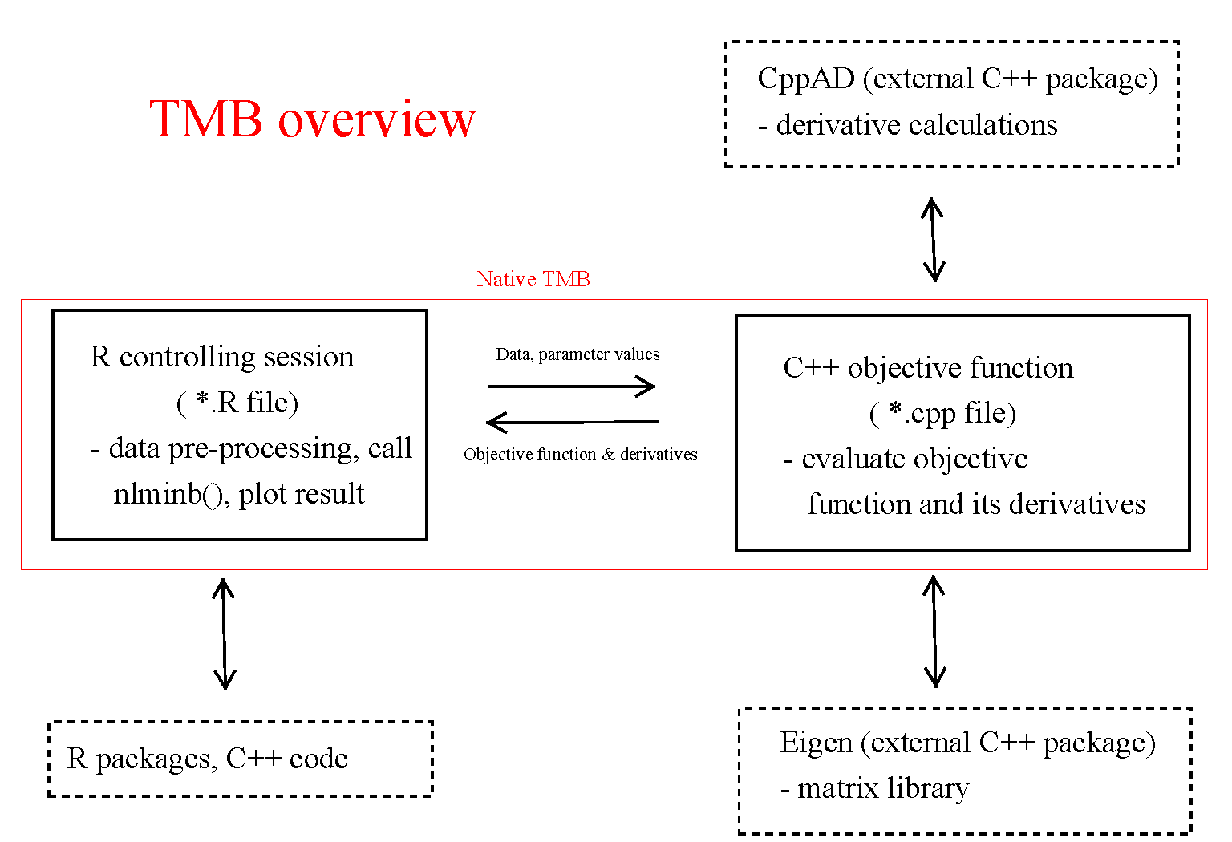
Taken from https://github.com/James-Thorson/2016_Spatio-temporal_models

Slide 5
The R link into things
setwd(“D:\\.....\\")
data <- list(x=rivers)
parameters <- list(mu=0,logSigma=0)
require(TMB)
compile(‘LectB1.cpp')
dyn.load(dynlib(‘LectB1'))
model <- MakeADFun(data,parameters)
fit <- nlminb(model$par, model$fn, model$gr)
rep <- sdreport(model)
List of Data
List of Estimated
Parameters
Create a DLL
Standard call to
nlminb
This code can be found in “LectB1.R”

Slide 6
Overview of the Process
Write the model and likelihood in XX.CPP
Define the data inputs as a list and the parameters as a list
Compile the cpp file.
Construction a model object using “MakeADFun”
Minimize the function (e.g. using nlminb)
Look at the results.

Slide 7
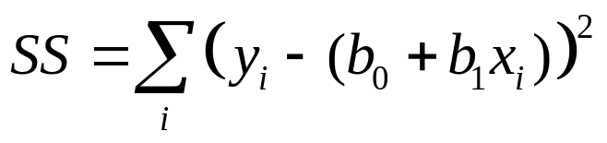
The First Real Example - I
We start with a least-squares problem:
  Find a and b by minimizing:
Program: LECTB2.CPP and LECTB2.R
Data File: LECTB2.DAT
Have a look at the various files

Slide 8
The First Real Example - II
R code
data <- read.table("LectB2.dat", header=TRUE)
parameters <- list(b0=0, b1=0, logSigma=0)
require(TMB)
compile("LectB2.cpp")
dyn.load(dynlib("LectB2"))
model <- MakeADFun(data, parameters, DLL="LectB2",silent=T)
fit <- nlminb(model$par, model$fn, model$gr)
best <- model$env$last.par.best
rep <- sdreport(model)
print(best)
print(rep)
Specify parameters
Compile and load
Create a model object
Fit the model and extract output
Note the file names are case-sensitive

Slide 9
The First Real Example - III
#include <TMB.hpp>
template<class Type>
Type objective_function<Type>::operator() ()
{
DATA_VECTOR(x);
DATA_VECTOR(y);
int n = y.size();
PARAMETER(b0);
PARAMETER(b1);
PARAMETER(logSigma);
vector<Type> yfit(n);
Type neglogL = 0.0;
yfit = b0 + b1*x;
neglogL = -sum(dnorm(y, yfit, exp(logSigma), true));
return neglogL;
}
Specify data
Specify parameters
Temp storage
Negative log-likelihood

Slide 10
Dissecting The Program
(arithmetic)
yfit = b0 + b1*x;
neglogL = -sum(dnorm(y, yfit, exp(logSigma), true));
The first line is a vector operation - it defines a vector, each element of which, yfit(i), is b0+b1*x(i).
The second line sums the likelihood (assumed to be normal) of the observed (y) data given the predicted (yfit) values – this is also a vector operation and follows the R formal.

Slide 11
Understanding MakeADFun
data: the data to be passed to the function (as a list)
parameters: a list of estimable parameters (including random and fixed effects)
map: provides a way to fix parameters (not estimate, or make parameters equal)
random: which variables are random
DLL: name of the DLL

Slide 12
Two phases (and map)
NA here means fixed
## Phase 1
map <- list(u=factor(rep(NA,data$nG)),log_sigma=factor(NA))
obj <- MakeADFun(data,parameters,map=map,DLL="nmix")
opt <- nlminb(obj$par,obj$fn,obj$gr)
pl <- obj$env$parList(opt$par) ## Parameter estimate after phase 1
## Phase 2
obj <- MakeADFun(data,pl,random="u",DLL="nmix")
opt <- nlminb(obj$par,obj$fn,obj$gr)

Slide 13
More on map
Lets say you have an vector beta and you want the 2nd and 4th elements to be same. You can achieve this using:
map(beta=factor(c(1,2,3,2)))

Slide 14
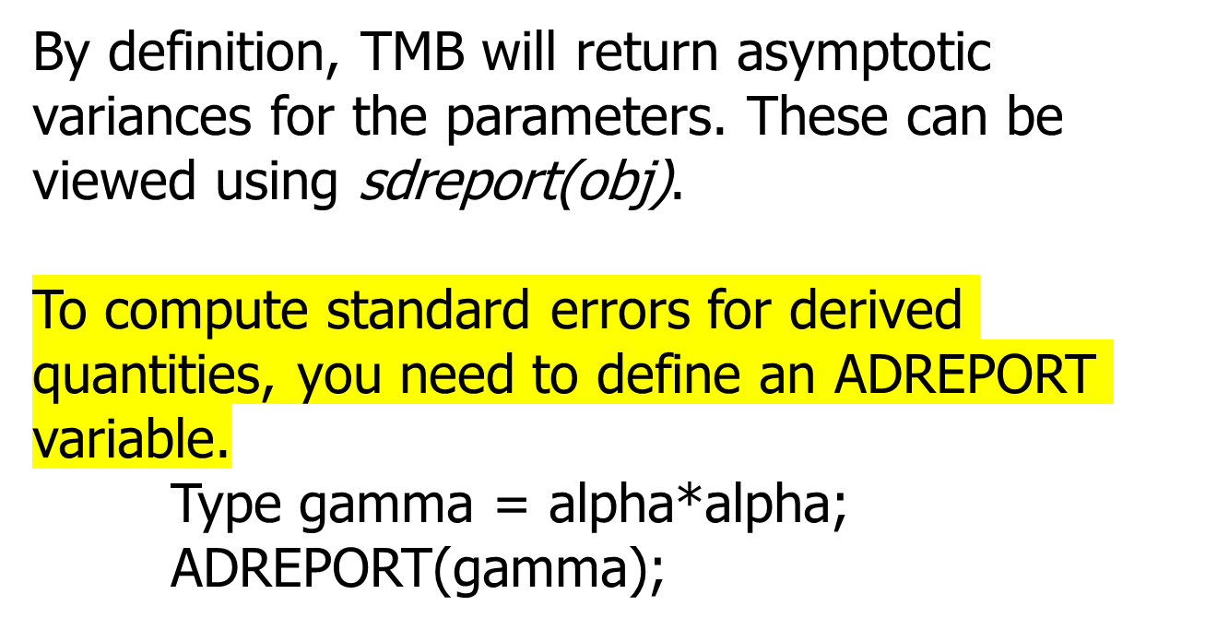
Sdreport

Slide 15
Getting variance information
To extract the Hessian matrix
model$he()
To extract the variance-covariance matrix for “model”:
solve(model$he())
To extract the correlation matrix for “model”
cov2cor(solve(model$he()))
To extract the standard errors for “model”
sqrt(diag(solve(model$he()))))

Slide 16
Reporting-I
To simply report results back to R (no variances), use
REPORT.
Type delta = alpha*alpha*alpha;
REPORT(delta);
To access the results being reported back to R use:
obj$report();

Slide 17
Reporting-II
To access the parameter estimates (fixed and random) use:
rep <- sdreport(obj)
summary(rep,select=“fixed”)
summary(rep,select=“random”)
xx <- summary(rep)
Use <- row.names(xx) == "SSB"
SSB <- xx[Use,]

Slide 18
Reporting-III
To report results back to R (with variances), use
ADREPORT.
REPORT(CW);
REPORT(N);
REPORT(S);
REPORT(SigmaR);
REPORT(Paa);
ADREPORT(FullF);

Slide 19
Something About Arithmetic
The following are the TMB arithmetic expressions:
  Z=a+b – addition (note Z+=b)
  Z=a-b – subtraction
  Z=a*b – multiplication
  Z=a/b – division
TMB implements all the standard functions (and more):
  Z=log(a)
  Z=exp(a)
  Z=square(a)

Slide 20
Declaring Variables
Before a variable is used, it has to be declared.
Key distinction among variables:
  Data that are passed from R (declared in the form DATA_XX(var_name) ).
  The parameters to be estimated (declared in the form PARAMETER(var_name) ). Note NO integer parameters!
  Temporary variables (declared in the form “Type xx”)
Notes:
Not at the local level
CITES listings

Slide 21
Data Types
TMB needs to know what dimensions and format your data/variables/parameters will be in!
The most-basic types:
  DATA_INTEGER (e.g. int Count) – integer.
  DATA_IVECTOR – vector of integers.
  DATA_IMATRIX – matrix of integers.
  DATA_IARRAY – array of integers.
  DATA_SCALAR (e.g. number) – real.
  DATA_VECTOR – vector of reals.
  DATA_MATRIX – matrix of reals.
  DATA_ARRAY – array of reals.
  DATA_STRUC – A structure.
  DATA_STRING – A string.
All variables MUST be declared before they are used – no exemptions!

Slide 22
Parameter Types
TMB needs to know what dimensions and format your data/variables/parameters will be in!
The most-basic types:
  PARAMETER - real
  PARAMETER_VECTOR – vector of real
  PARAMETER_MATRIX – matrix of real

Slide 23
Local variables
Type p; [scalar]
vector<Type> q(5); [vector]
matrix<Type> z(5,5); [matrix]
array<Type>k(5,5,5); [array]
int I; [integer]
vector<int>jj(5); [integer vector]

Slide 24
Structures
If you have a bunch of data elements they can packaged into a structure:
template <class Type>
struct dataSet{
int Nyear;
vector<int> Nlen;
matrix <int> SelSpec;
vector <int> Fleet_area;
matrix <type> Area_fleet;
array <Type> SelPnt;
array <int> RetPnt;
};
Structures can be passed in functions
Setting up the element of a structure
dataSet<Type> dataset;
DATA_INTEGER(Nyear); thedata.Nyear = Nyear;

Slide 25
Variable Names-I
Variable names:
  Must start with an alphabetic character.
  Don’t use any reserved words (if, else, etc.)
  Choose descriptive, but not overly long, variable names (e.g. biomass, MSY).
  TMB is case-sensitive, i.e. the variables biomass and Biomass are NOT the same variable.

Slide 26
Variable Names - II
Other rules / hints:
  Use underscores to split names within a variable name (e.g. my_biomass).
  Avoid re-using the same variable for different purposes.
  Don’t forget those semi-colons!
  All arrays start at 0 (this is C), which can be confusing for R users.

Slide 27
Getting more information
When I get stuck (yes it happens). I go to online resources:
The TMB documentation within R
Kaspars documentation: https://kaskr.github.io/adcomp/index.html
“The Book” http://kaskr.github.io/adcomp/_book/Introduction.html

